Slide 1
Let’s create a clear path to care
[add presenter details]

Slide 2
Our recent journey
Visioning consultations
Doctor of BC & Ministry of Health strategic plans
Health authority priorities
Joint collaborative committees
GPSC programs & initiatives, including A GP for Me

Slide 4
Our vision
To enable access to quality primary health care that effectively meets the needs of patients and populations in BC, using the patient medical home to form the foundation for care delivery within a broader, integrated system of primary and community care.

Slide 5
Our goals
Quality Access
Capacity
Work environment
Linkages

Slide 7
Working in new ways
Patient needs
Workforce
impacts
System
sustainability

Slide 8
Working in new ways: doctors
Right care, right place, right time
Work-life balance and physician wellness
Healthy and vibrant work environments

Slide 9
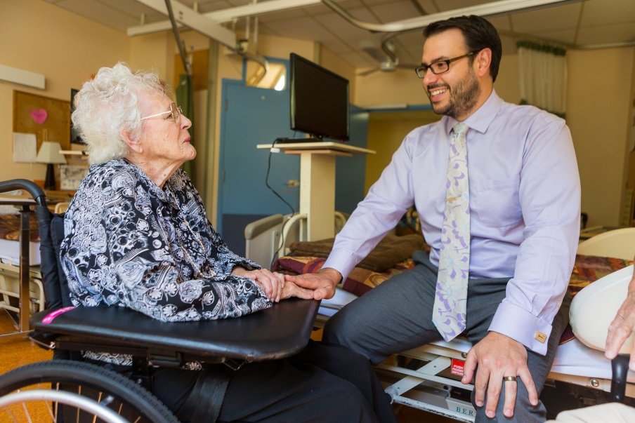
Working in new ways: patients
Meet the needs of patients now and into the future
timely access
continuous, coordinated care

Slide 10
Working in new ways: system
Manageable impacts of a changing workforce
Strong, healthy, and affordable health care

Slide 11
Governance
Primary and Community Care (PCC) Project Steering Committee
Local Collaborative Action Committees
GPSC

Slide 12
Patient medical home in BC

Slide 13
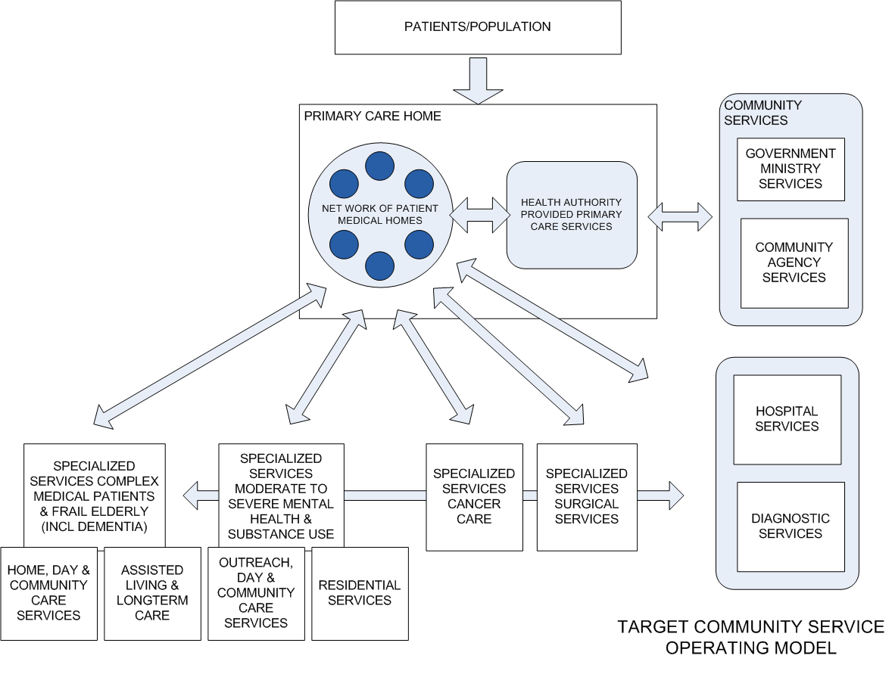
Integrated System of Primary and Community Care
STREAM 1 GPSC-led
STREAM 2 HA-led

Slide 14
Streams of work
Establish PMH & PCH
physician led
Stream 1
Stream 2
Integrated & Coordinated Services
Streamline integrated & specialized services
health authority led

Slide 15
The role of the GPSC
Establish a joint vision and direction
Provide strategic leadership and supports for PMH/PCH
Co-develop policy and direction for community systems of care
Ensure resourcing is directed to best support doctors
Provide leadership and change support for PMH
Influence system barriers

Slide 16
Areas of focus
Current state & population needs
Physician engagement
Tools & resources

