Slide 1
Moving forward: Primary Care in BC
[add presenter’s name]

Slide 2
Our recent journey: GPSC visioning
1,100+ GPs shared 5,000 thoughts | Nearly 500 GPs participated in online conversations | 740+ GPs attended 26 face-to-face meetings

Slide 3
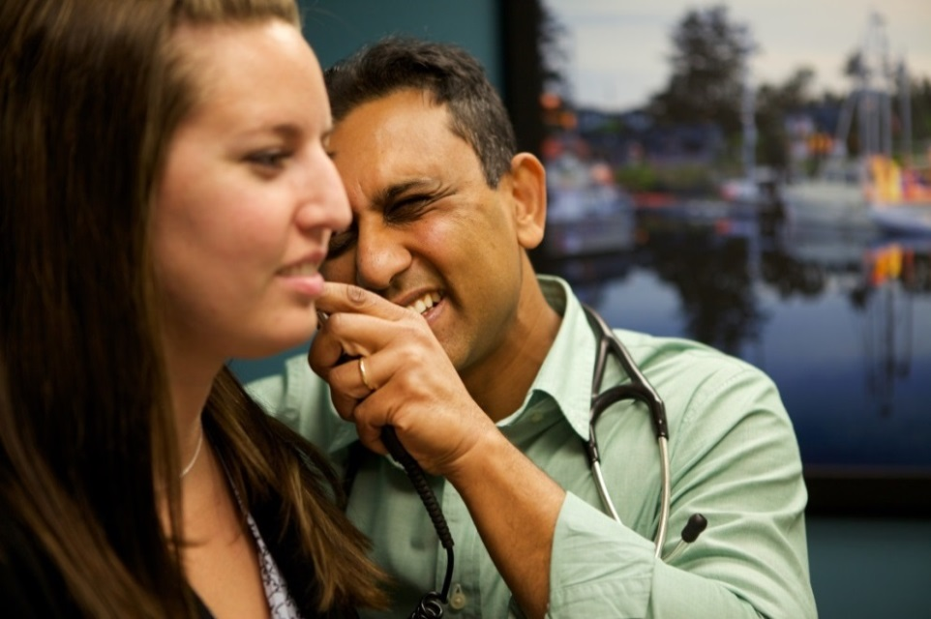
Our recent journey: A GP for Me
35 Divisions of Family Practice
Themes:
Team-based care
Practice support and efficiencies
Support for vulnerable populations

Slide 4
Case for change

Slide 5
Spring 2016: GPSC joint vision

Slide 6
Our goals
To provide patients better access to comprehensive primary care through their GP’s office (Patient Medical Home)
To integrate primary & community care so that it wraps around
patients and their families.
I don’t need to worry about navigating multiple waitlists
My GP knows the whole story of my care
My records, care plan, my care providers are linked.

Slide 7
Patient Medical Home & Primary Care Home
coordinated care
streamlined & accessible care

Slide 8
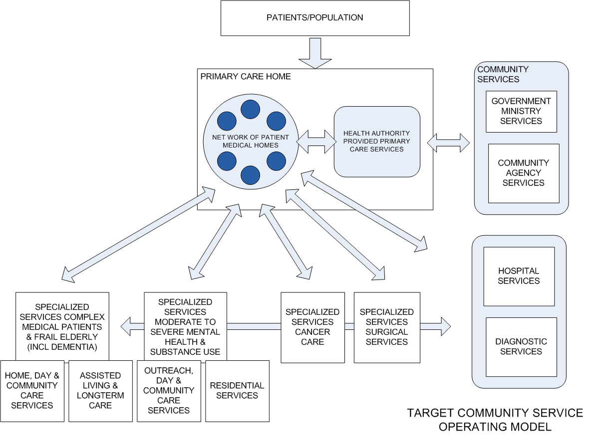
Integrated System of Primary and Community Care
STREAM 1 - GPSC led
STREAM 2 - HA led

Slide 9
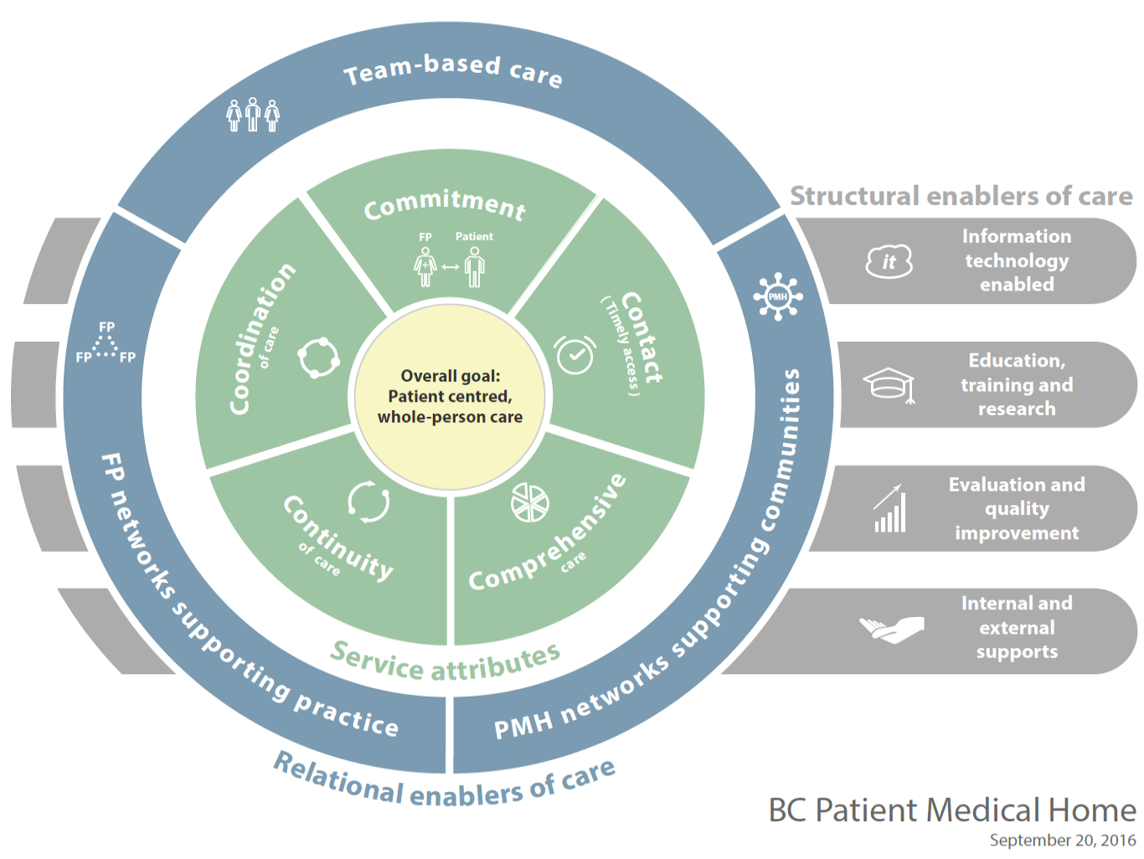
12 attributes of a PMH

Slide 10
Main streams of work
Establish PMH & PCH
physician led
Stream 1
Stream 2
Integrated & Coordinated Services
Streamline integrated & specialized services
health authority led

Slide 11
Areas of work: stream 1
Practice level
Developing networks (DoFP)
System-level partnerships

Slide 12
Areas of work: stream 2
Mental health & addictions
Frail elderly

Slide 13
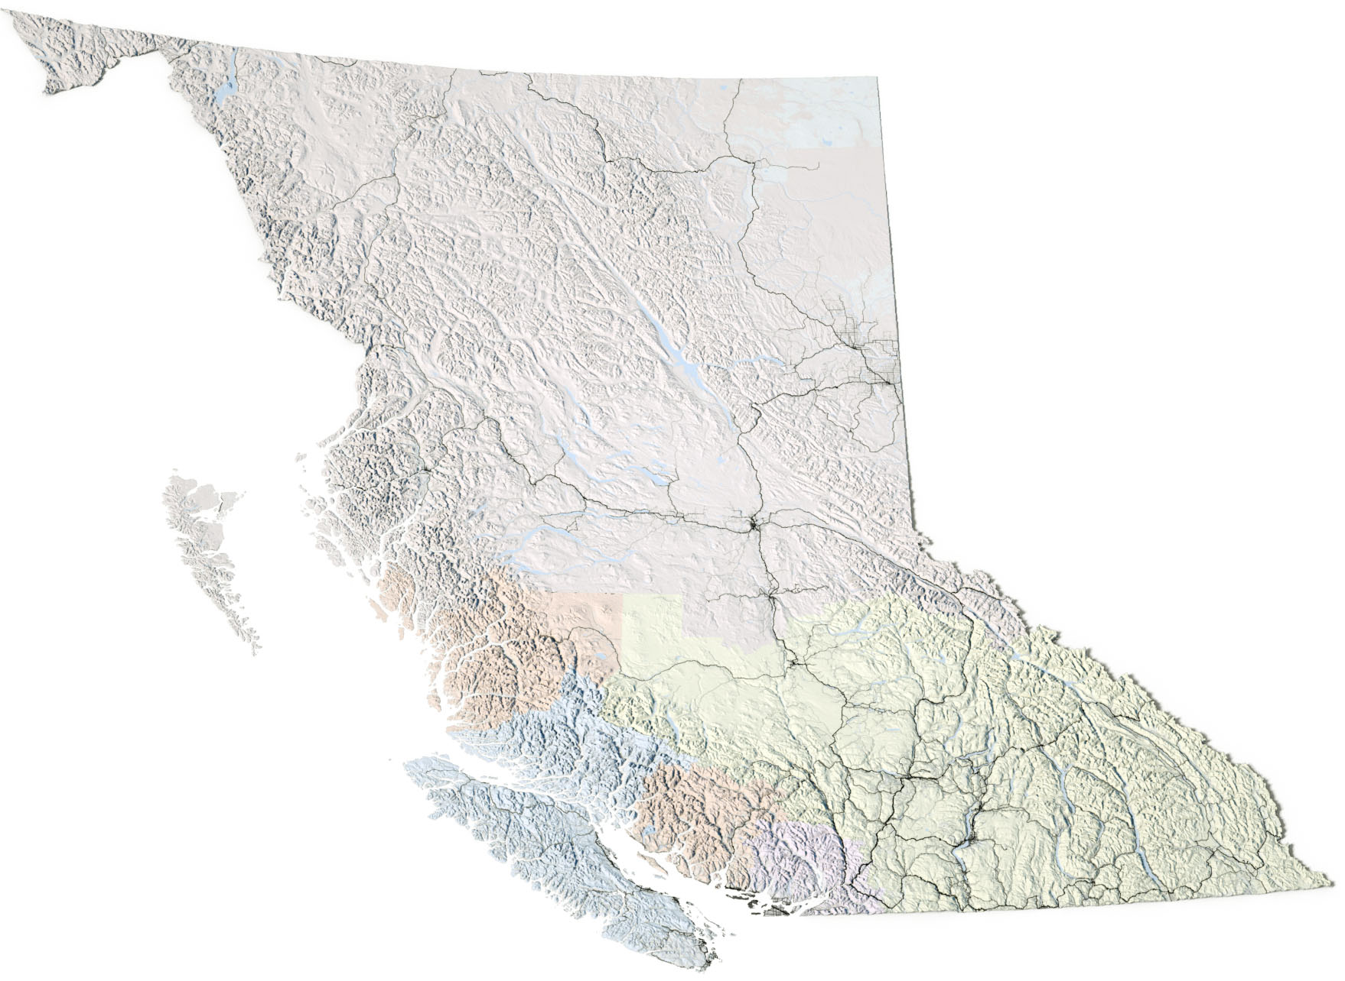
Getting started with some initial proof of concept communities
2016/17
2017/18
2018/19
FHA:
Abbotsford
Fraser NW
Mission
Surrey
IHA:
Kamloops
Kelowna
Kootenay Boundary
Penticton
Vernon
VCHA:
North Shore
Richmond
Vancouver – West end
VIHA:
Campbell River
Comox
Duncan/Cowichan
North Saanich
Oceanside
Port Alberni
Victoria
NHA:
Fort St. James
Prince George
Vanderhoof
Minimally underway in 15 GSAs
Minimally underway in a further 20 GSAs
Remaining 26 or less GSAs

Slide 14
Our key ongoing work
Local divisions
Practice support & QI in practice
Incentive fees
Proof-of-concept communities
Physician input
Support for GP networks
Integrating learnings

Slide 15
Next steps
September
meeting with physician leads
October
more clarity about how a PMH will look in a doctor’s office
November
specific resources & supports for practices and divisions
provincial event

Slide 16
E gpsc@doctorsofbc.ca | W www.gpscbc.ca

